Slide 1


Team Details
  Team name: altuhraK
  Team leader name: Normansyah Putra
  Problem Statement: Meal QC, ingredient traceability and Gemini-powered quality control for school-meal kitchens and food businesses, on Google Cloud.

Slide 2
THE PROBLEM
Three blind spots in school-meal kitchens
BEFORE COOKING
Nobody knows where the ingredients came from
Deliveries are not recorded per lot. When people fall ill, no one can say which supplier, how far the food travelled or how warm it arrived.
BEFORE SERVING
Meals are checked by eye and not recorded
Quality control happens under time pressure and leaves no trace. A missing protein or vegetable is noticed only after someone has eaten.
AFTER SERVING
Illness reports cannot be checked quickly
Real outbreaks arrive mixed with inflated or copy-pasted claims. Without delivery and ingredient records, sick children wait or kitchens are blamed unfairly.

Slide 3
THE IDEA
Know what went into every meal. Gemini checks and explains; people decide.
1 · Trace ingredients
Each lot records supplier, origin, travel time, arrival temperature and price.
2 · Check the tray
Crew photographs each tray; Gemini lists which components are present or missing.
3 · Review it
A supervisor accepts, holds or rejects. Nothing is approved automatically.
4 · Triage reports
Illness reports are checked against what was served and traced back to suppliers.

Slide 4
OPPORTUNITIES
Why Meal QC is different
A · HOW IS IT DIFFERENT?
Food-QC tools stop at detection; complaint channels only collect messages. Meal QC links the ingredient lot, the tray check, the delivery record and the illness report in one audited flow.
B · HOW DOES IT SOLVE IT?
Supply checks flag warm, late, expiring or overpriced deliveries. Gemini flags a missing component, so the batch is held before it leaves. Illness reports are compared with portions served and traced to suppliers in one click.
C · UNIQUE SELLING POINT
Supplier-to-plate, health first. Any meal traces back to its suppliers. Conflicts never lower medical priority. Gemini explains but cannot accuse, score or close a case.

Slide 5
FEATURES
Eight features, one record
Lot traceability
Supplier, origin, distance, transit time, arrival temperature and price per lot.
Supply insights
Warm arrivals, use-by dates, stock cover, price vs reference, punctuality.
Gemini tray check
Photo vs versioned manifest; structured JSON output.
Human review
Accept, hold or reject; final, audited, model vs fallback shown.
Illness report form
Public, care-first; phones hashed, photos fingerprinted.
Claim integrity
8 checks vs delivery records and between reports; trace to suppliers.
Gemini incident summary
Plain-English pattern and checks; cannot change the score.
Tuning pipeline
Household-plate dataset to Vertex AI supervised tuning.
Amber ingredient supply · Green tray quality control · Red illness-report triage · Grey learning layer. Plus a built-in guide and help on every screen.

Slide 6
PROCESS FLOW
Supplier to plate, one audit trail
1 · SUPPLY — BEFORE COOKING
Supplier
ships a lot
Kitchen door
origin, time, temp
Receiving
accept · return
Checks
warm · expiry · price
Lot linked
to meal date
2 · TRAY QC — BEFORE SERVING
Crew
photographs tray
Gemini
lists components
Validator
rejects bad output
Supervisor
accept · hold · reject
Official record
audited
3 · ILLNESS REPORTS — AFTER SERVING
Parent / school
reports illness
Incident
kitchen × day
8 checks
vs delivery records
Gemini
explains pattern
Human decision
trace to supplier
Learning loop: reviewed photos → labelled dataset → Vertex AI tuning → tuned Gemini endpoint, switched in by configuration. Lane 3 traces back through lane 1 to the supplier.

Slide 7
MOCK · INGREDIENT TRACE
From an illness report to the supplier in one click
What the Supply page checks
Arrival temperature and cold chain
Transit time and supplier punctuality
Use-by date and days of stock cover
Price vs reference (100 = reference; above 115 is expensive, below 80 suspiciously cheap)
A weekly priority list combines every check, with suggested actions.
TRACE · OUTBREAK DAY (DEMO SCENARIO)
Chicken
Supplier
Trader, no cold chain
Distance travelled
145 km
Arrival temperature
11.5 °C
Every lot used on the meal date, where it came from and how it arrived.

Slide 8
ARCHITECTURE
Serverless on Google Cloud, asia-southeast2
Kitchen crew · receiving
CLOUD RUN · FRONTEND
Next.js 16
Home, Supply, Crew, Review, Report, Illness reports, Guide. Server-side proxy; no keys in the browser.
CLOUD RUN · BACKEND
FastAPI
Supply lots, inspections, claim integrity, RBAC, append-only audit.
Vertex AI · Gemini
tray vision, incident summary
Supervisor / Admin
Firestore
lots, records, audit
Parents · schools
Cloud Storage
tray images
Identity: one least-privilege service account (aiplatform.user, datastore.user, scoped storage); ADC via the metadata server.
Delivery: images in Artifact Registry tagged by git SHA; scale-to-zero, max 2 instances; staging and production isolated.
Learning: dataset in Cloud Storage → Vertex AI supervised tuning → tuned endpoint via one env var.

Slide 9
TECHNOLOGIES
Google AI at the core, open stack around it
Layer | Technology | Google service
Generative AI | Gemini Flash · multimodal · structured output (responseSchema) | Vertex AI
Model tuning | Supervised tuning pipeline (validate, group split, SFT export) | Vertex AI tuning · Cloud Storage
Backend | Python 3.12 · FastAPI · Pydantic v2 · Pillow · httpx | Cloud Run
Frontend | Next.js 16 · React 19 · TypeScript · Tailwind CSS v4 | Cloud Run
Data | Ingredient lots, records, audit trail, inference cache | Firestore · Cloud Storage
Security | Least-privilege service account · ADC · role scopes | IAM
Delivery & QA | Containers by git SHA · unittest · Playwright E2E | Artifact Registry

Slide 10
ESTIMATED IMPLEMENTATION COST
No fixed infrastructure; pay per use
LOW · DEMO, FEW RUNS A DAY
$2–5
per month
MEDIUM · DAILY USE
$10–25
per month
HIGH · ALWAYS WARM, HEAVY USE
$50+
per month
Gemini inference dominates the bill (about 2.2k input tokens per tray check). Cost controls in place: scale-to-zero, max 2 instances, bounded concurrency and timeouts, no Cloud SQL, VMs or load balancer.
Estimate dated 2026-10-16 for asia-southeast2, two Cloud Run services; Gemini pricing changes — verify before budgeting.

Slide 11
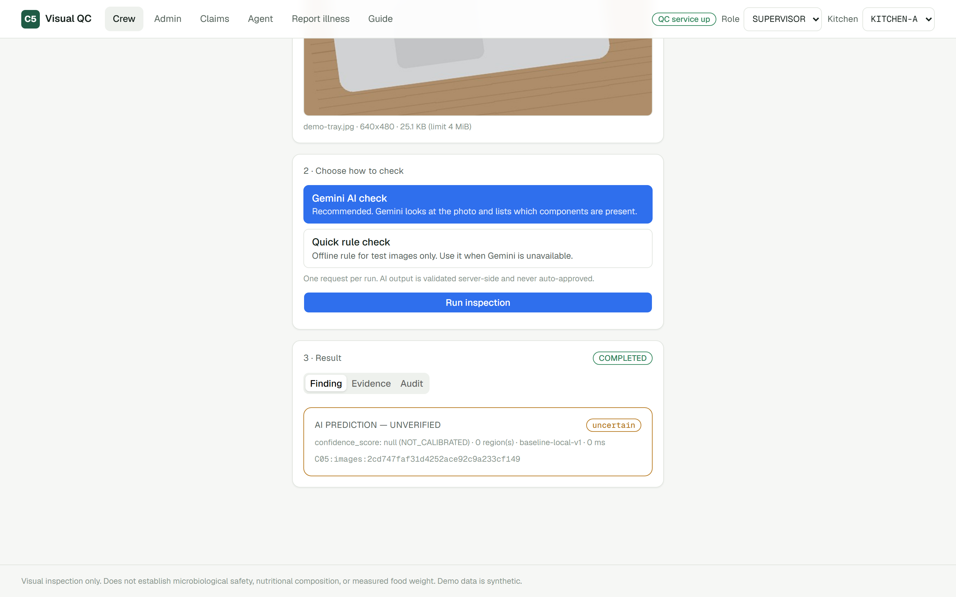
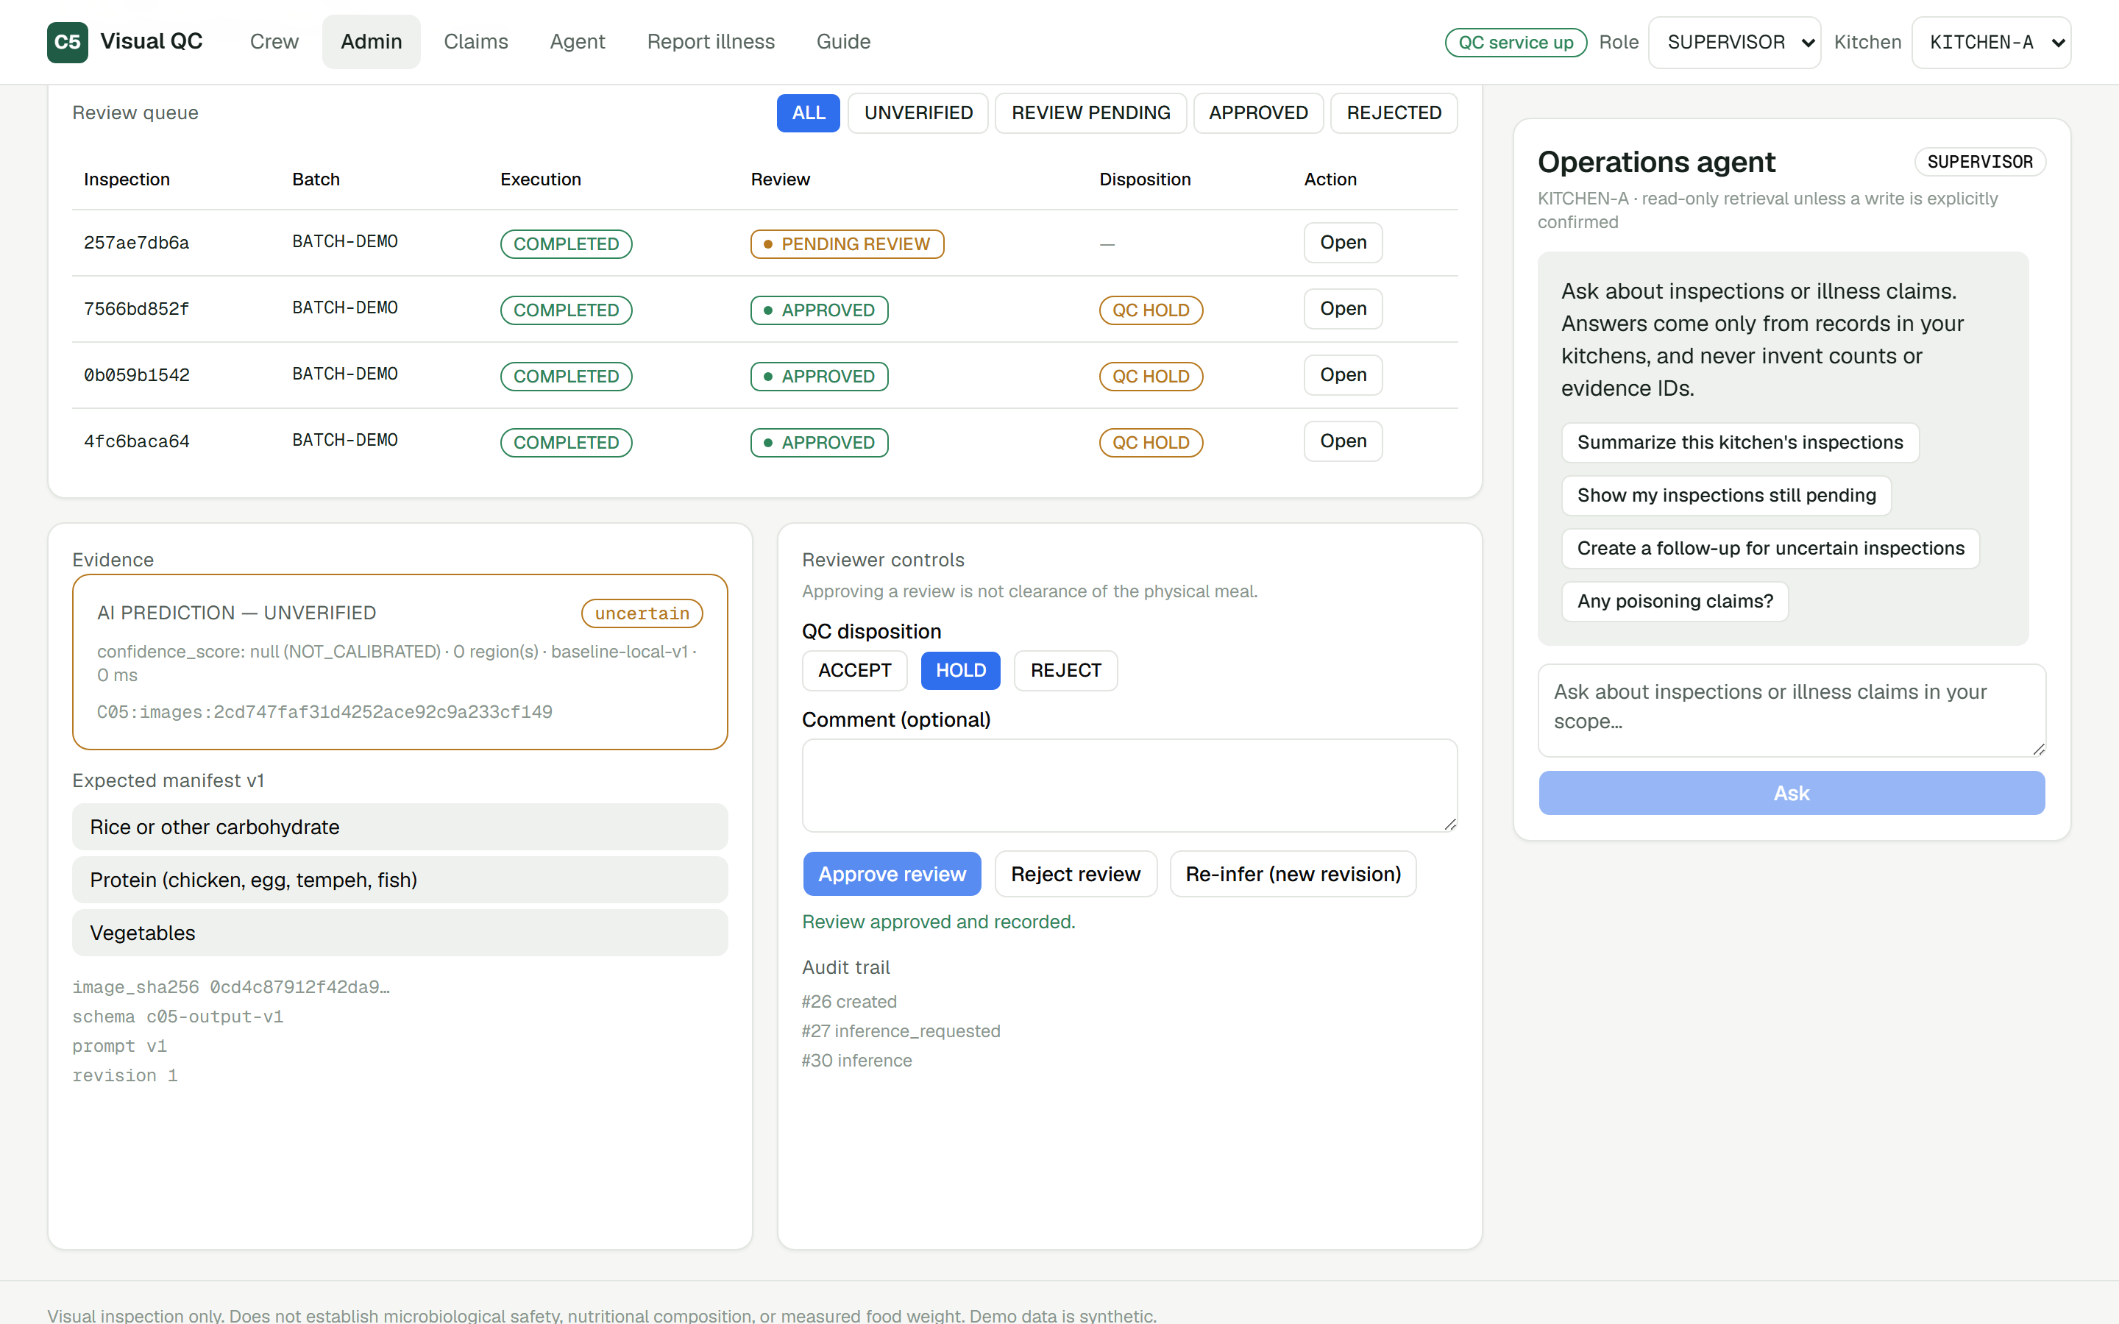
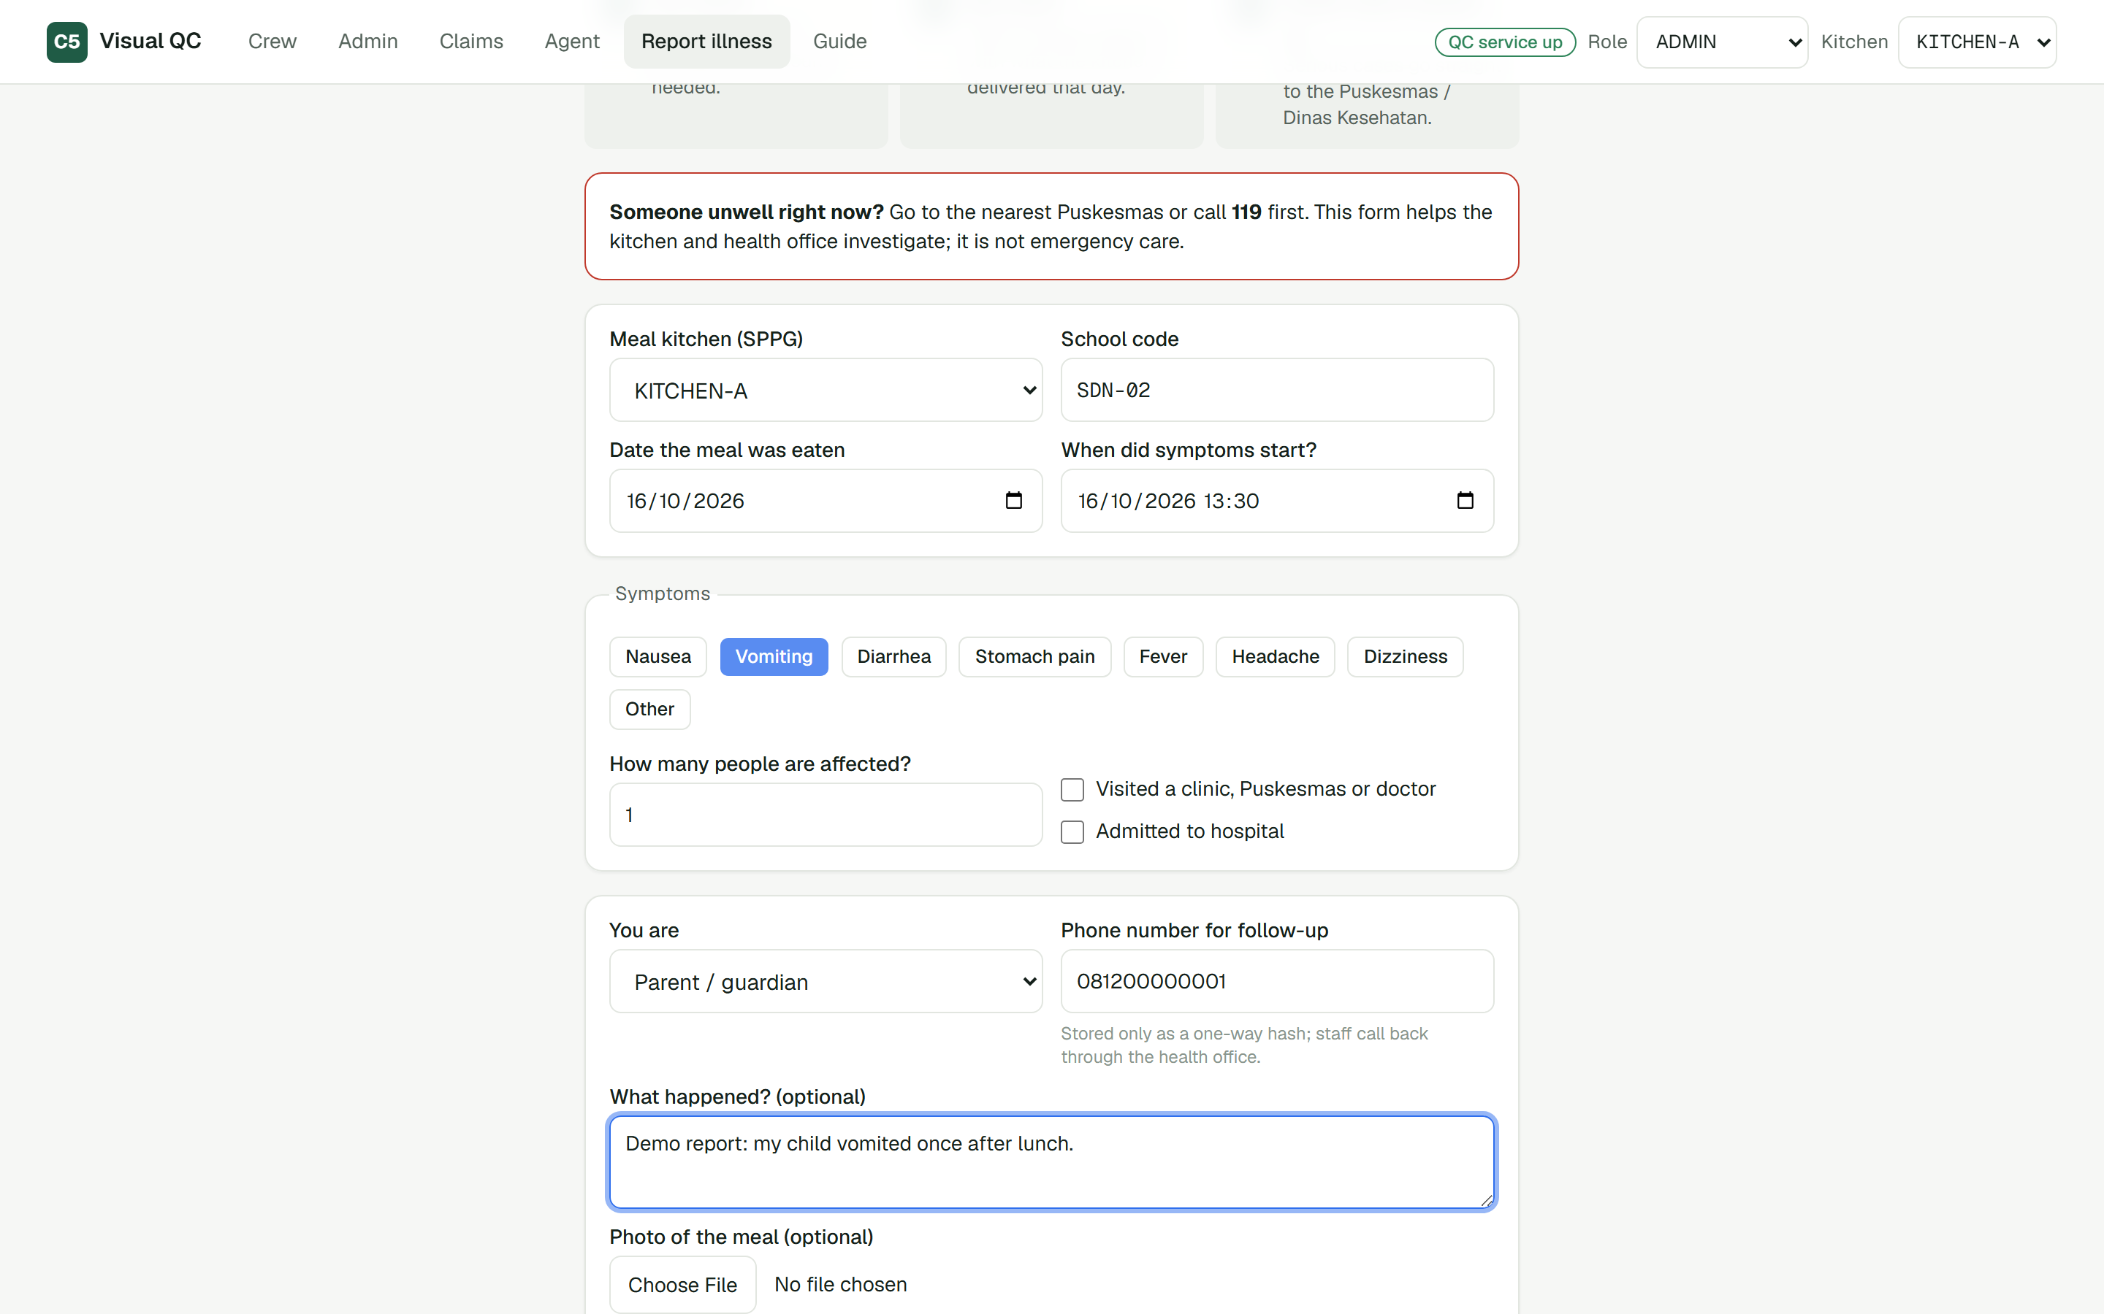
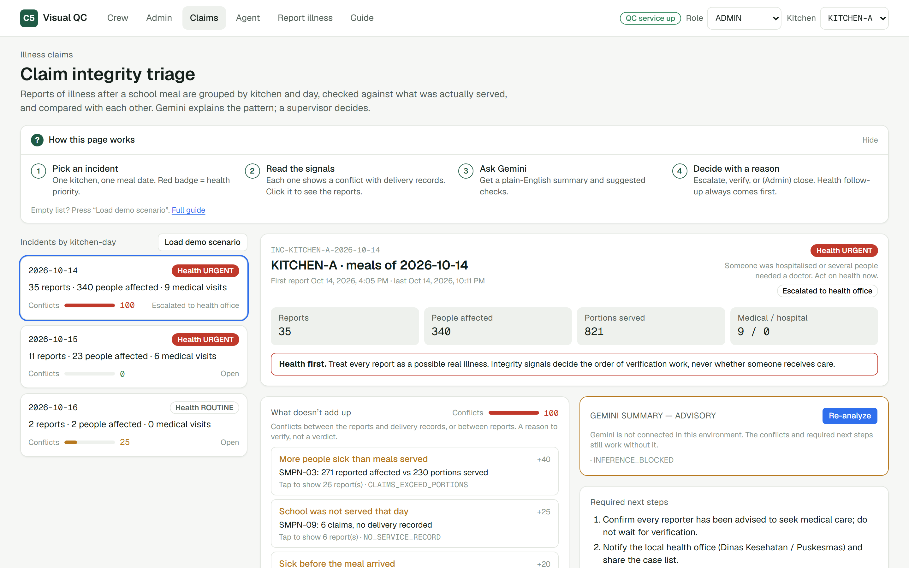
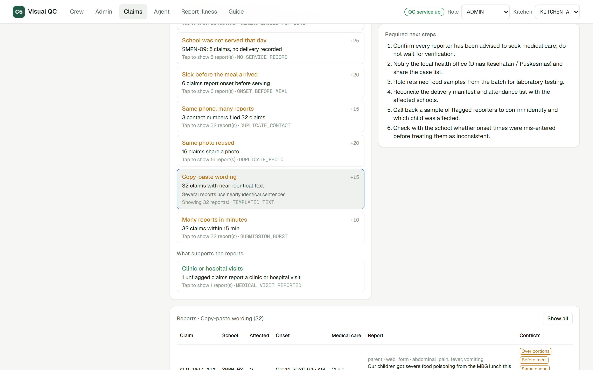
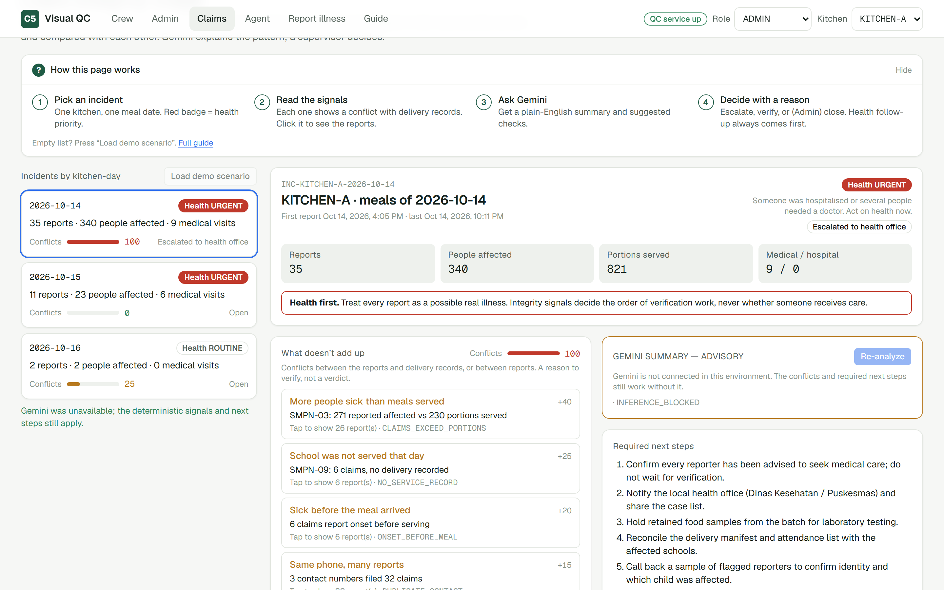
PROTOTYPE
Snapshots of the prototype
Crew: photo vs manifest, result marked UNVERIFIED
Supervisor: accept, hold or reject — audited
Public report: care first; phone stored as a hash
Incident: health priority stays URGENT
Signals: plain-language conflicts, one click to reports
Outbreak: zero conflicts plus medical evidence

Slide 12
PERFORMANCE & BENCHMARKING
Measured, not assumed
7.5 s
Gemini tray check in production (≈2.2k input / 255 output tokens)
5×
faster with thinking off: 2.0 s vs 10.9 s, same payload
300/300
coordinated reports flagged; 0/700 genuine hit by a strong signal
76 + 18
automated tests, plus 18/18 browser checks on the deployed build
Offline API, p50 (in-process, SQLite) | ms | Claim triage, one incident | time
Create inspection (image intake) | 35 | 50 reports | 8 ms
Submit illness report | 16 | 200 reports | 66 ms
Admin overview | 52 | 500 reports | 0.2 s
Incident detail (35 reports) | 93 | 1,000 reports | ≈2 s
Gemini figures: deployment evidence (gemini-2.5-flash, Vertex AI). Triage figures: synthetic scenarios, 30% coordinated; burst-only matches excluded from “strong”. Not a field-accuracy claim.

Slide 13
FUTURE DEVELOPMENT
From prototype to pilot
Tune on household plates
Pipeline is ready: label real photos, group-split, tune Gemini on Vertex AI, compare per plate type.
Field pilot in one region
A few kitchens and their schools; measure missed-component recall and time-to-escalation.
Health-office integration
Hand escalated incidents to Puskesmas / Dinas Kesehatan with the case list and retained-sample IDs.
More report channels
WhatsApp and school-staff intake feeding the same incident model.
Real accounts and audit export
Sign-in per role, per-kitchen tenancy, signed audit exports.
Offline-first crew app
Queue photos when the kitchen’s connection drops; sync later.
The model can be upgraded or swapped for a tuned endpoint by configuration alone.

Slide 14
LINKS
Provide links to your:
GitHub Public Repository
github.com/noiz354/altuhraK-ai-builder-cup-2026
Demo Video Link (3 Minutes)
[YouTube link]
Final Product Link — start with the Guide
c05-frontend-723420820074.asia-southeast2.run.app
Meal QC · Know what went into every meal. People decide. Every step is audited.

Slide 15


